Slide 1
Regional Validation Workshop on the use of
Geographical Information Systems in the energy sector
July 26-28, 2016
Dakar, Senegal
Energy and Rural Electrification Planning
in Nigeria
Engr. A. Adebisi
Director, Renewable and Rural Power Access
Federal Ministry of Power, Works and Housing, Nigeria
&
Obehi Eguakhide
EcoPro Resources Limited

Slide 2
Introduction
High level validation of Action Plans of RE, EE &SE4ALL
FMPWH in collaboration with EU/GIZ and working with REA is developing a rural electrification GIS mapping of the country

Slide 3
Nigeria’s SE4All Targets
Energy Access Targets:
To increase electricity access to 75% & 90% by 2020 & 2030 respectively; Access to modern energy for cooking of 53% & 78% in 2020 & 2030; Use of Butane Gas (LPG) or (CNG) of 15% & 25% by 2020 & 2030; Firewood consumption to reduce by 50% in 2020
Renewable Energy Targets:
Renewable Energy mix of 38% and 31% by 2020 and 2030 respectively: 28% hydro (SM&L hydro), 6% solar, 1% biomass and 3% wind by 2020 20% hydro (SM&L hydro), 7% solar, 1% biomass and 4% wind by 2030
Energy Efficiency Targets:
Overall, EE will increase by at least 20% by 2020 and 50% by 2030; 40% Efficient lighting by 2020 and almost 100% by 2030;
18

Slide 4
Electricity Access Projection – 2030
7
4

Slide 5
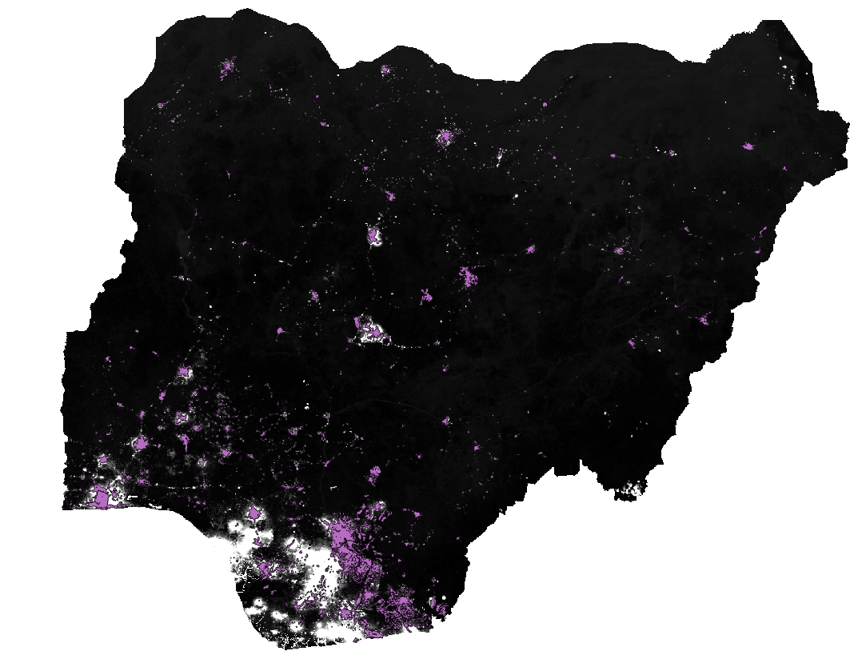
Geographical Distribution of Electrified Communities in Nigeria
Map showing electrified and un-electrified clusters
9
Notes:
5

Slide 6
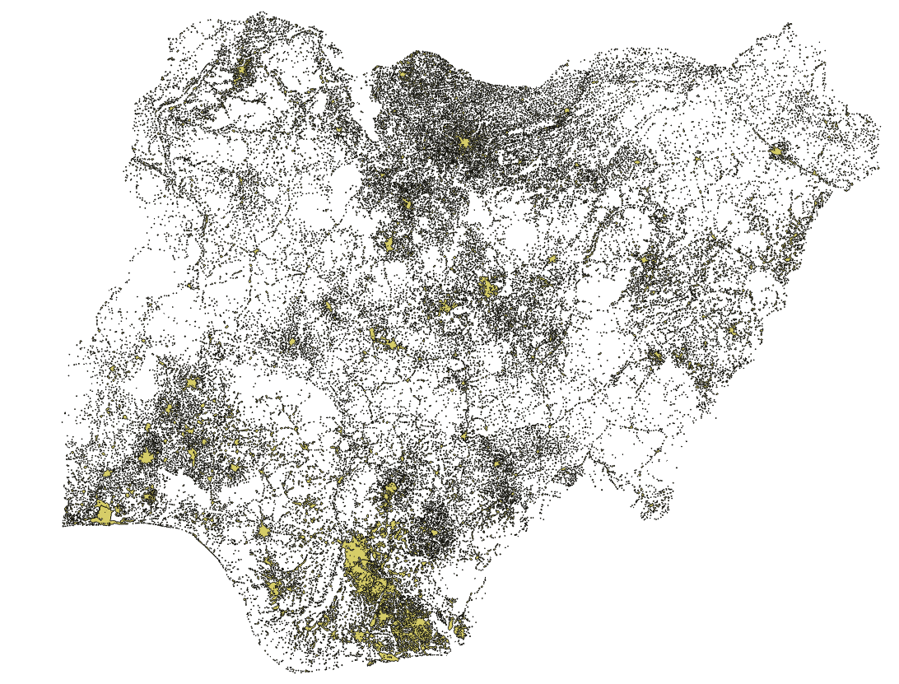
Nigeria’s Power Sector Potentials
Federal Ministry of Power, works and housing.
A recent study by GIZ/FMoP identified a total of 47,489 population clusters spread across the country and also established that out of the population of 193.4 million (NPC 2016) people, 174 million people lived within the clusters.

Slide 7
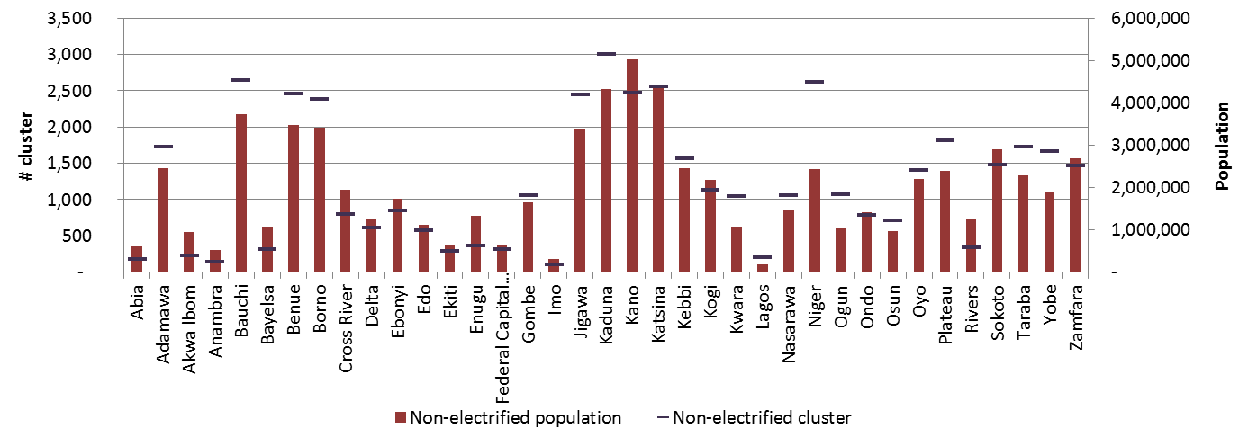
Planning - Status of Electrification
In total 45,456 clusters are non-electrified (95 %)
But only 83 out 181 million people living in the non-electrified area (46 %)
Including 10m people living outside clusters assumed to be non-electrified
The clusters with the largest number of people are all electrified

Slide 8
Thank you

Slide 9
Energy and Rural Electrification Planning in (NAME OF THE COUNTRY)
For more information, please contact
Engr. A. Adebisi
Director, Renewable and Rural Power Access
Federal Ministry of Power, Works and Housing
+2348075443121
yomibisi@yahoo.com
&
Engr. Faruk Y. Yusuf
Assistant Director, Renewable and Rural Power Access
Federal Ministry of Power, Works and Housing
+2348038521476
fyyabo@gmail.com

