Slide 1
Regional Validation Workshop on the use of
Geographical Information Systems in the energy sector
July 26-28, 2016
Dakar, Senegal
Energy and Rural Electrification Planning
in The Gambia
Sanna Fatajo
Ministry of Petroleum & Energy

Slide 2
OUTLINE
Energy and Rural Electrification Planning in The Gambia
Country Profile
Map
Introdution
Tools

Slide 3
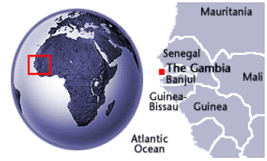
Country Profile
Energy and Rural Electrification Planning in (NAME OF THE COUNTRY)
Total surface area of 11,300 sq. km
Population of approximately 1.8 million (2013 census)
Economy driven mainly by agriculture, tourism, re-export trade
Biomass, including fuelwood, accounts
for about 80% of the country’s energy
supply, and for more than 90% of
household energy consumption.

Slide 4
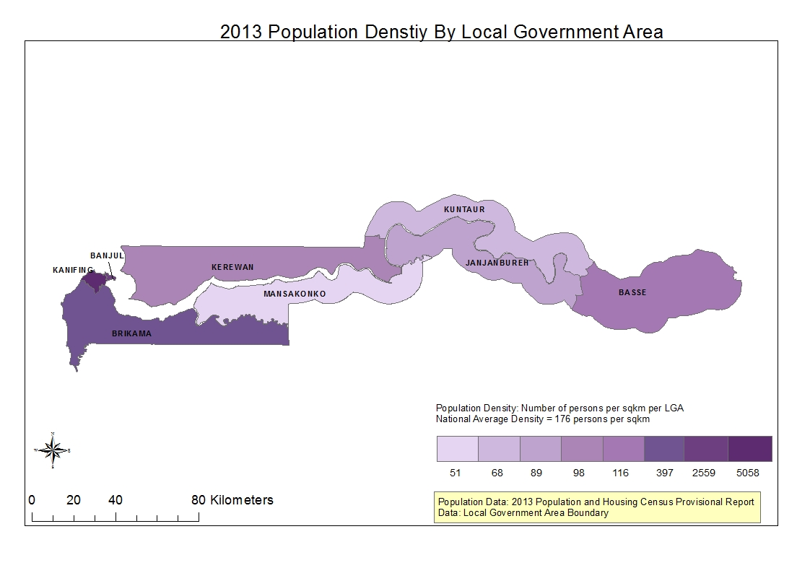
MAP
Energy and Rural Electrification Planning in The Gambia

Slide 5
INTRO
Energy and Rural Electrification Planning in The Gambia
Energy and Rural Electrification planning institutions: Ministry of Petroleum and Energy and the Utility (NAWEC).
On the general energy planning process the Ministry normally takes the lead. However, their capacity is very limited as they have started recruiting planners very recently. The Director of Energy is responsible for overall.
The Utility has had their planning cadre well established. However, they concentrate more on electricity than other forms of energy. On rural electrification, NAWEC has a unit in place and it is headed by Mr. Kanteh (bkanteh@yahoo.com)
Moreover, there are some other institutions like GBoS and NEA that have quite a level on GIS. However, there informations are not energy specific but relevant for energy planning.

Slide 6
Tools
Energy and Rural Electrification Planning in The Gambia
Energy planning tool: The Ministry with the utility and the regulator has recently undergone a training on the MESSAGE software for energy planning, The Utility also has some tools and softwares that are used for electricity planning.
GIS implementation: Currently, the Utility has a unit that is task for GIS data collection and electricity planning in general. Mr. Adams is responsible for this unit (stanleysebja@yahoo.co.uk).
Energy Information Systems (SIE): The country has no SIE in place. It has scattered and fragmented data in different institutions like the Ministry, GBoS, NEA,PURA, the Utility.

Slide 7
Energy and Rural Electrification Planning in The GAMBIA
Merci
Obrigado
Thank you
Sanna Fatajo

